Slide 1
Maximum Likelihood Estimation MLE

Slide 2

Estimation of Parameters of Normal distribution
Let us make assumption that variable x follows normal distributed
Density function of normal distribution with mean μ and variance σ² is given by :
Id | x
1 | 1
2 | 4
3 | 5
4 | 6
5 | 9

Slide 3
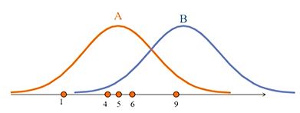
Estimation of Parameters of Normal distribution
The data is plotted on a horizontal line
Think which distribution A or B , is more likely to have generated the data?

Slide 4
Answer
Answer is A because the data are cluster around the center of the distribution A, but not around the center of distribution B
Hence by looking at the data it is possible to find the distribution that is most likely to have generated the data

Slide 5
Estimation Procedure
MLE starts with computing the likelihood contribution of each observation
likelihood contribution is the height of the density function
We use L_{i} to denote the likelihood contribution of i^{th} observation

Slide 6
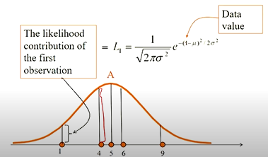
Graphical Illustration of Likelihood contribution

Slide 7

Estimation Procedure
Multiply the likelihood contribution of all observations. This is called likelihood function. We use notation L
likelihood function L =
In our example , n=5

Slide 8
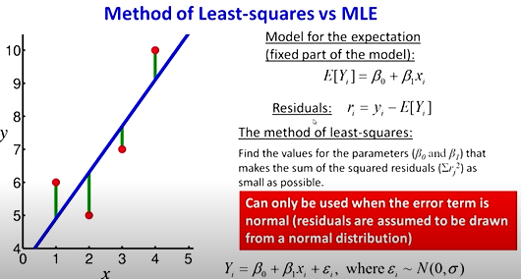

Slide 9
Estimation of Regression Parameters
Model such as y=β₀ + β₁ + u can be estimated using MLE
u is error term
Assume that u follows normal distribution with mean 0 and variance σ²
We can write the model as
u = y – (β₀ + β₁ x)
This means that y – (β₀ + β₁ x) follows normal distribution with mean 0 and variance σ²
The likelihood contribution of each data point is the height of the density function at the data points y – β₀ + β₁ x

Slide 10
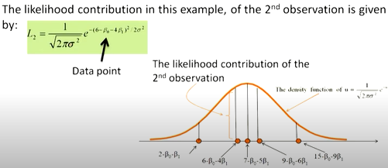
Estimation of Regression Parameters

Slide 11
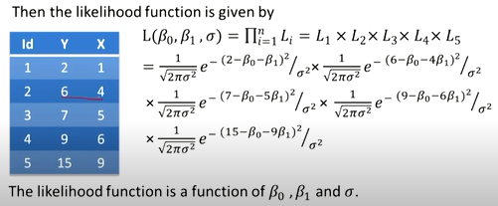
Estimation of Regression Parameters

Slide 12
Choose the values of β₀ , β₁ and σ that maximizes the likelihood function

